Slide 1
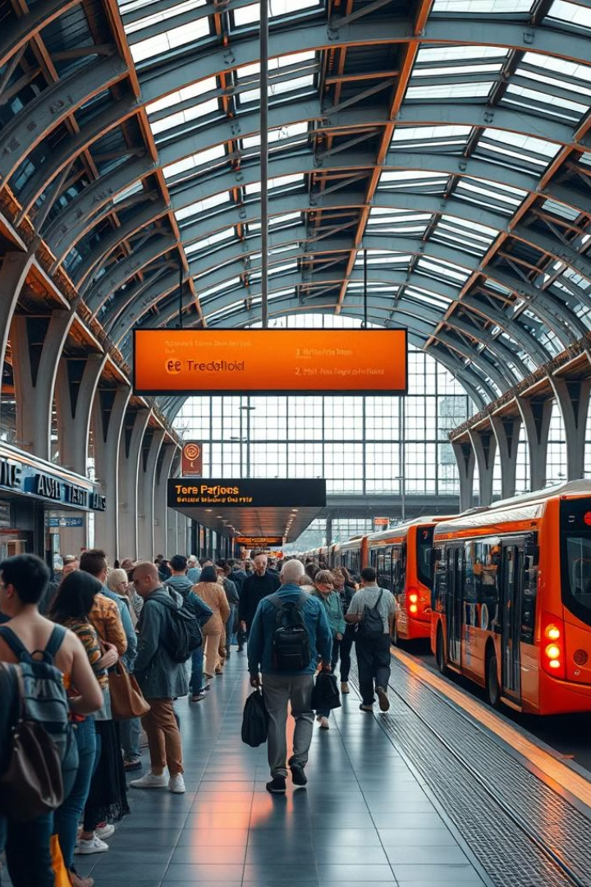
Bus Ticket Reservation System
BY
Sanjay kishore T - 231801152
Sanjay N - 231801149
Ramesh M - 231801134

Slide 2
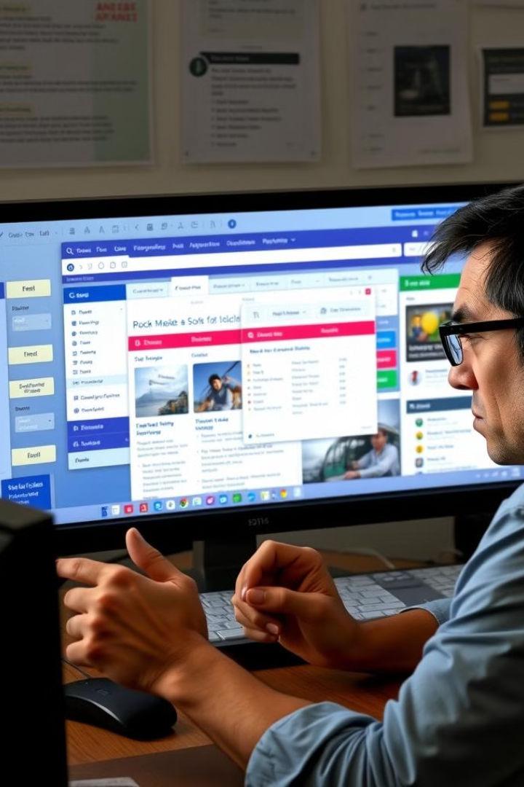
Problem Statement
1
Outdated Systems
2
Limited Functionality
Many existing bus reservation systems are outdated and difficult to navigate, leading to frustration for customers.
Current systems often lack advanced features such as real-time seat availability, flexible payment options, and comprehensive trip planning.
3
Inefficient Management
Bus companies struggle to efficiently manage bookings, schedules, and passenger data, leading to operational challenges.

Slide 3
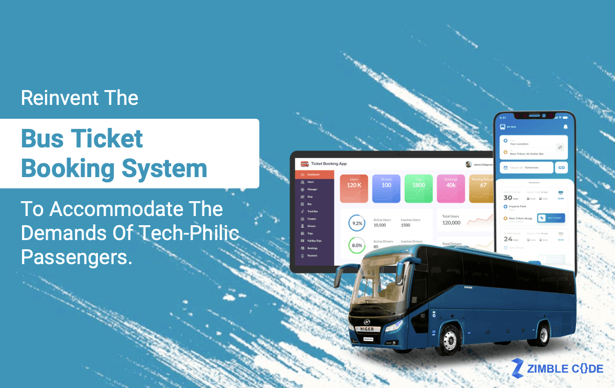
Objective
Seamless Booking
Real-time Information
Provide a user-friendly and intuitive booking process, allowing customers to easily search, select, and purchase bus tickets.
Offer up-to-date information on bus schedules, seat availability, and trip details to help customers make informed decisions.
Efficient Management
Enhanced Customer Experience
Equip bus companies with a comprehensive system to manage bookings, passenger data, and operational logistics.
Deliver a positive and memorable experience for bus passengers, fostering customer loyalty and satisfaction.

Slide 4
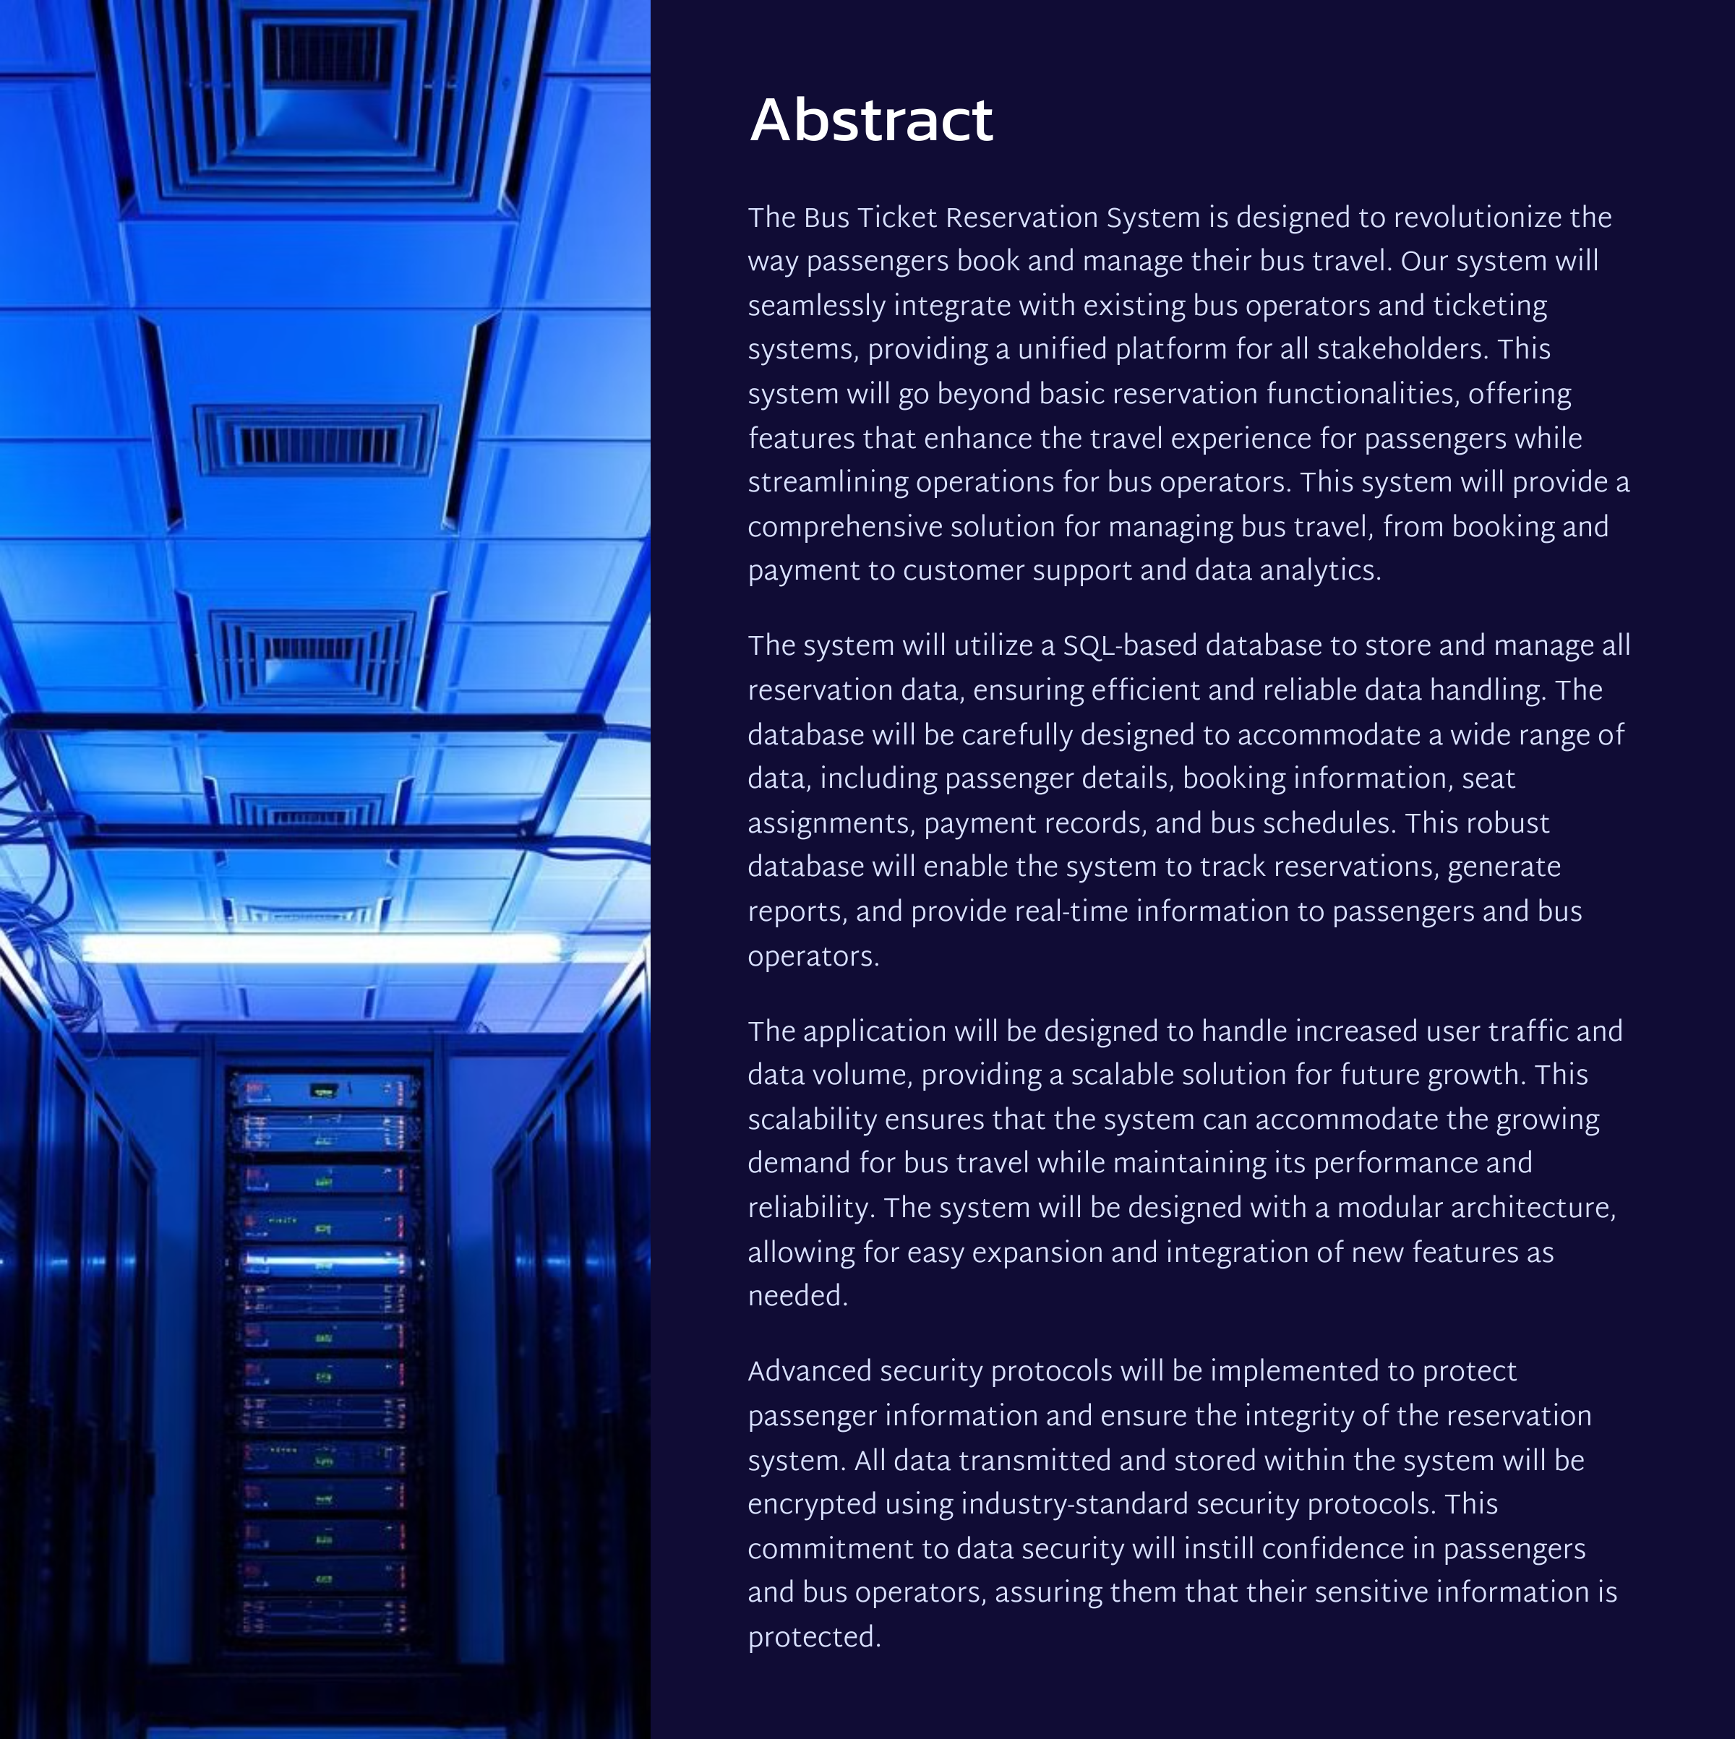

Slide 5
Existing System
An existing bus ticket reservation system is a digital platform that enables passengers to book tickets online, select seats, and make secure payments. It allows bus operators to manage schedules and track sales in real-time. Notable examples include RedBus in India and Greyhound in the USA.
Problems in existing system
Inconsistent Data
Profile management issues.
Information about bus avaliability,schedules and price are not
upto date.

Slide 6
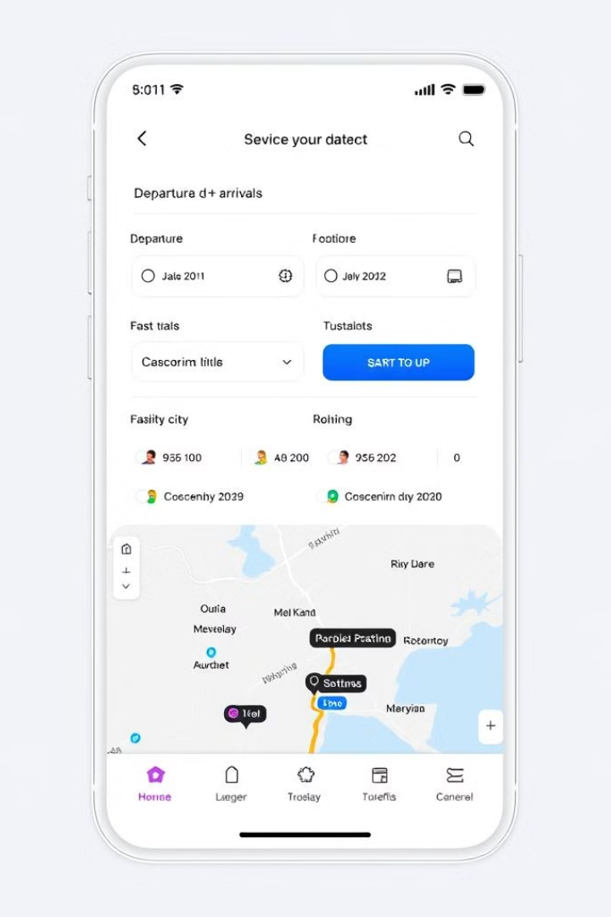




Proposed System
Contactless Ticketing:
Description: QR codes or NFC for boarding to minimize physical contact.
Benefits: Enhances safety and speeds up the boarding process.
Online Booking
Customers can easily search, select, and book bus tickets through a user-friendly web application.
Dynamic Pricing Models:
Features: Algorithms to adjust prices based on demand, time of booking, and occupancy rates.Benefits: Maximizes revenue for companies and offers competitive pricing for customers.
Data Analytics
Bus companies can leverage comprehensive data analytics and reporting tools for improved operational decision-making.

Slide 7

Disadvantages of Existing System
1
Limited Availability
2
Complex Interface
Existing systems often have limited availability, especially during peak travel seasons.
Many systems have complex interfaces that can be difficult to navigate and use.
3
Lack of Flexibility
4
Poor Customer Support
Existing systems often lack the flexibility to accommodate different travel needs and preferences.
Customer service can be slow and unreliable, leading to frustration and dissatisfaction.

Slide 8
Advantages of Proposed System
Increased Availability
User-Friendly Interface
Enhanced Flexibility
The system offers a wider range of bus routes and schedules, making it easier for users to find the perfect trip.
The intuitive and user-friendly interface makes the system easy to use for everyone, regardless of technical experience.
Users can customize their travel plans by choosing seats, adding baggage options, and selecting additional services.

Slide 9
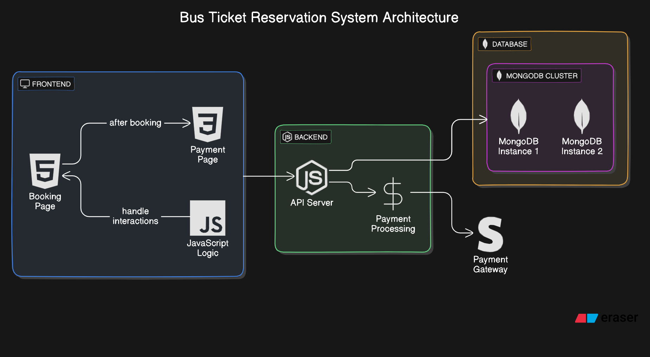
Architecture Diagram

Slide 10

Modules with Description
User Management
Handles user registration, login, and account management.
Route Management
Manages bus routes, schedules, and availability information.
Booking Management
Processes ticket bookings, seat selection, and payment processing.
Reporting and Analytics
Generates reports and insights on system usage and performance.
Customer Support
Provides online support and assistance to users.

Slide 11
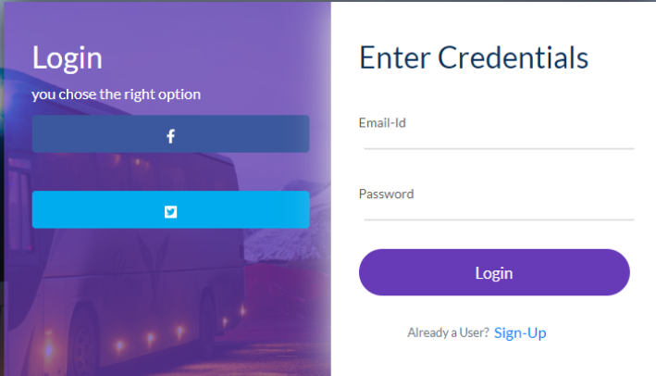
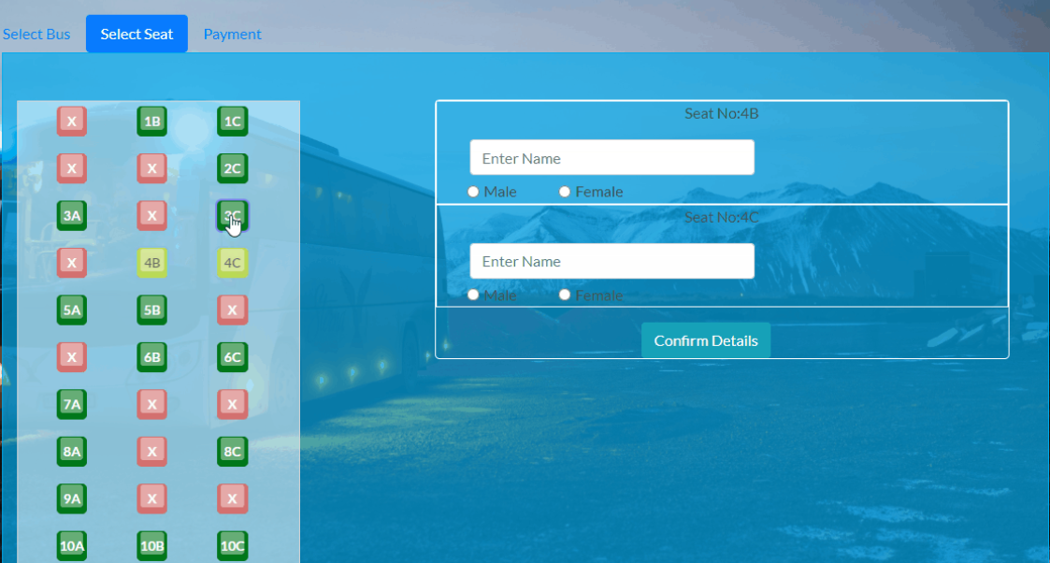
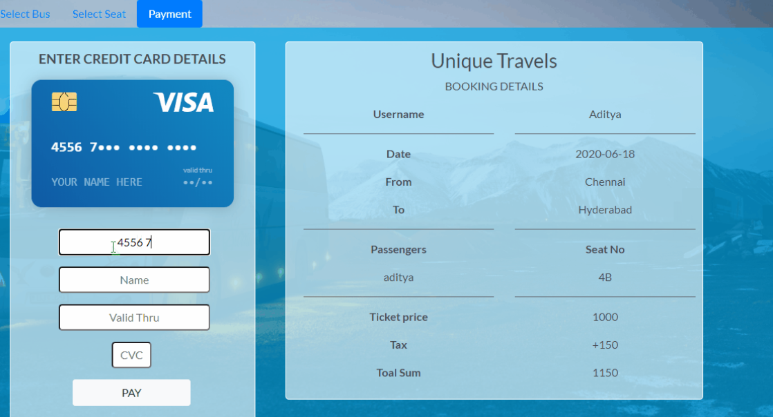
Sample Outputs
lLOGIN PAGE
Seating chart
Booking Confirmation
The login feature of the Bus Ticket Reservation System securely authenticates users, allowing them access to booking and managing their tickets.
Interactive chart allowing users to choose their preferred seats during the booking process.
Email containing confirmation booking, including important trip details.

Slide 12
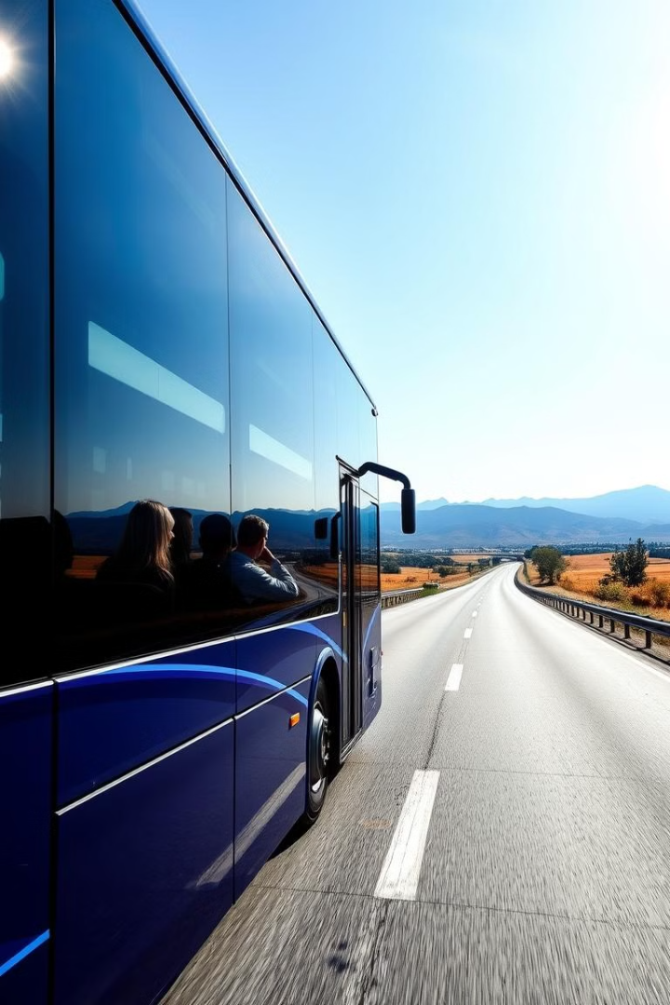



Conclusion and Future Work
User-Centric Approach
The proposed system aims to deliver a user-friendly and efficient experience for travelers.
Integration with Other Services
Future development could include integration with other travel services, such as hotel bookings and flight reservations.
Data Analytics and Optimization
Analyzing user data and feedback will help improve the system's functionality and optimize service offerings.

Slide 13
REFERENCES
1.Brown, S., & Smith, J. (2021). Web Development with Node and Express. O'Reilly Media.
2.Bank, D., & Grisham, T. (2020). Mastering MongoDB: Building Modern Database Applications. Packt Publishing.
3.Adams, B. (2019). Node.js Design Patterns. Packt Publishing.
4.Petrichenko, S., & Beighley, L. (2018). HTML and CSS: Design and Build Websites. Wiley.
5.Powell, J., & Chen, J. (2020). Modern Full-Stack Development: Using React, Node, Express, and MongoDB. Apress.
6.Express Documentation. (n.d.). Retrieved from https://expressjs.com/
7.MongoDB Documentation. (n.d.). Retrieved from https://www.mongodb.com/docs/
8.HTML and CSS Documentation. (n.d.). Retrieved from https://developer.mozilla.org/en-US/docs/Web
9.Passport.js Documentation. (n.d.). Retrieved from https://www.passportjs.org/
10.Stripe API Documentation. (n.d.). Retrieved from https://stripe.com/docs/api

